Slide 1
Environmental & Climate Data Analysis
Presented By:
Sarthak Goswami, Priyansh Gangwar, Krishna Garg

Slide 2
Project Overview
This project explores climate trends using a sample
Global Surface Summary of the Year (GSOY) dataset.
We analyze average temperature and precipitation
patterns across multiple years.
Key steps:
- Data Cleaning & Preprocessing
- Handling Missing Values
- Feature Normalization
- Visual Analysis & Interpretation

Slide 3

Dataset Information
Source: GSOY Sample Dataset
Total Records: 41 years
Key Features:
- DATE (Yearly)
- TAVG (Average Temperature)
- TMAX (Max Temp)
- TMIN (Min Temp)
- PRCP (Precipitation)
Cleaned and transformed columns
for analysis

Slide 4
Data Cleaning and Preparation
Converted DATE to datetime format and
extracted YEAR
Filled missing values in:
- TAVG using mean imputation
- PRCP using forward-fill method
Normalized:
- TAVG and PRCP using Min-Max Scaling

Slide 5
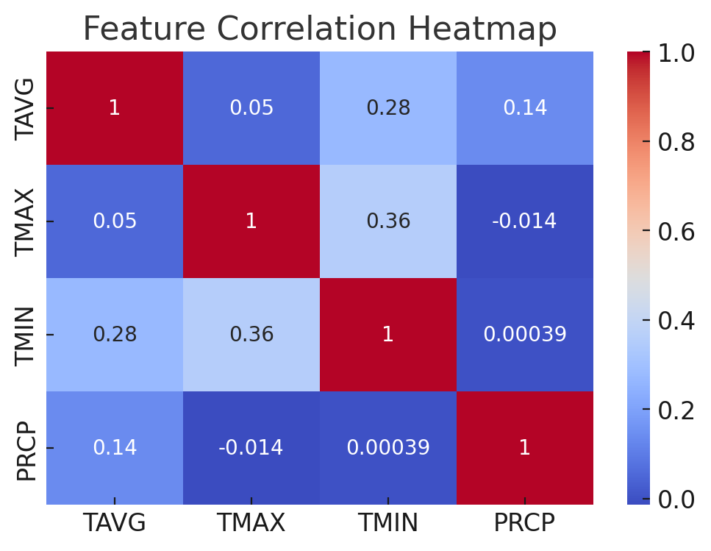
Correlation Heatmap
Observations:
Strong correlation
observed between
TAVG, TMAX, and
TMIN
PRCP shows less
correlation with
temperature features

Slide 6
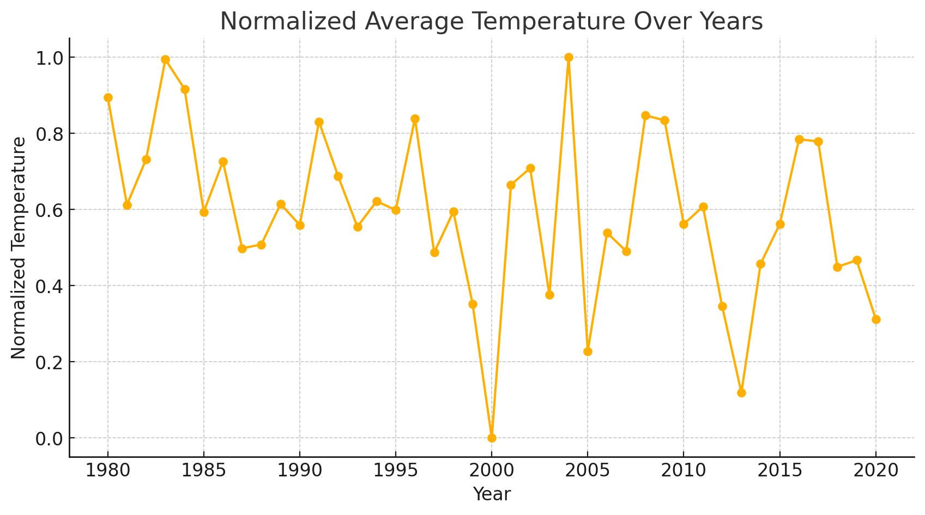
Normalized Average Temperature Over Years
Observations:
Gradual increase in normalized average temperatures
Reflects possible climate warming patterns

Slide 7
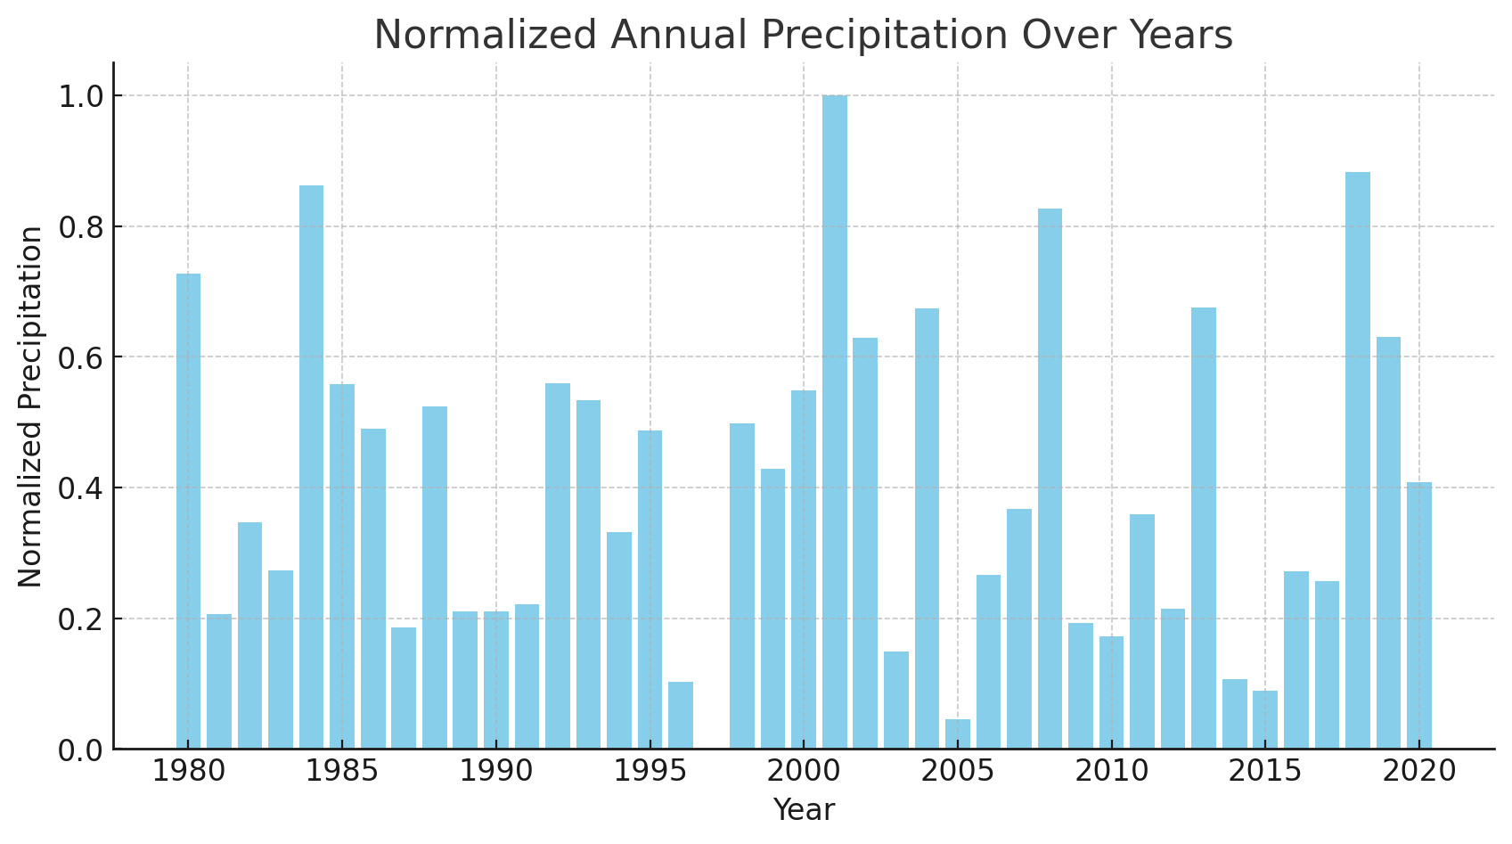
Normalized Annual Precipitation Over Years
Observations:
Precipitation levels show fluctuations over the years
No clear increasing or decreasing trend

Slide 8
Summary Statistics
 | Metric | TAVG | TMAX | TMIN | PRCP
 | Mean | 15.78 | 19.14 | 11.11 | 863.92
 | Std Dev | 2.67 | 2.09 | 2.60 | 193.83
 | Min | 8.62 | 15.68 | 6.16 | 551.75
 | Max | 20.67 | 24.88 | 14.86 | 1326.63

Slide 9

Conclusion
Average temperature shows a rising trend over the years
Precipitation remains variable with no consistent pattern
Data preprocessing ensures robust insights
Future work: Regional comparison, advanced forecasting, CO₂-level impact

Slide 10
Thank you

